Slide 1

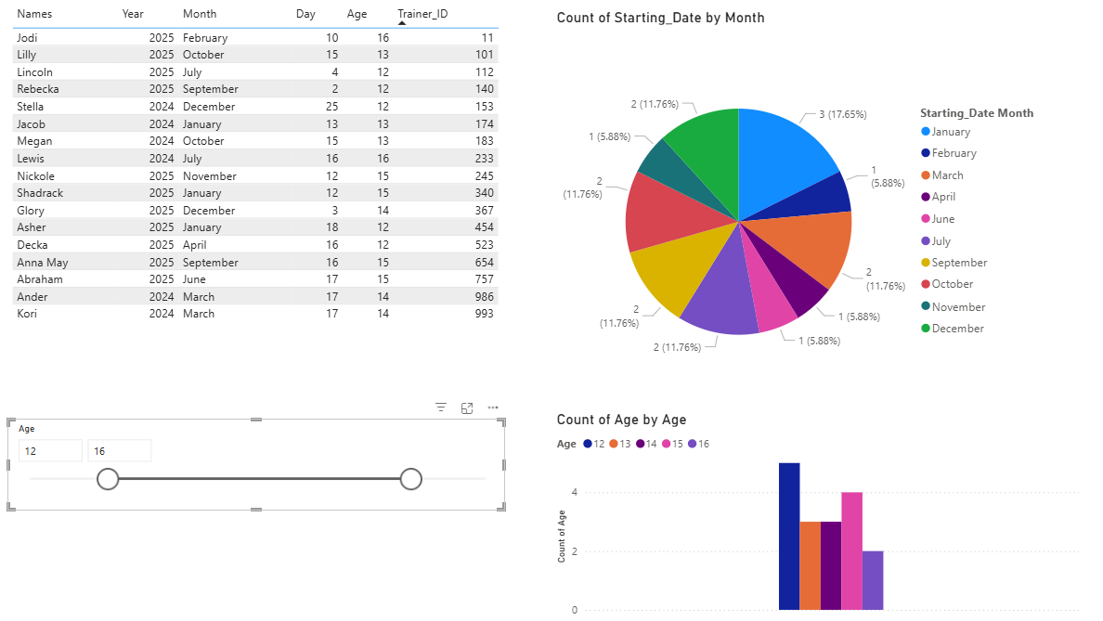
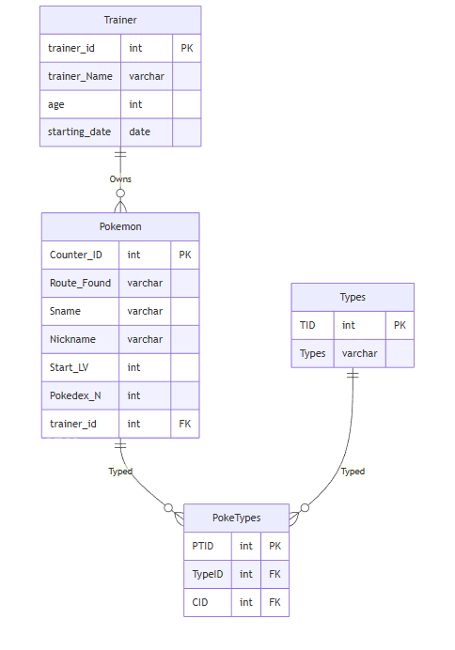
Pokémon Nuzlockes
Your name | Huntington University | CS 415 Database Management – Fall 2025 - Final Project
Overview
Data
Reports
This is a database that will be used for Pokémon Nuzlockes. This can be used for multiple people or even for one person across multiple Pokémon games. With a Pokémon table to hold most basic info needed about the Pokémon captured. One table to show off all the types; With one to connect the Pokémon to the typing charts. And finally, one to hold all basic information on the person's trainer character. Describing how the database will be used from a user’s perspective.
In the eyes of the view this will just make things easier. This is shown in the fact that all the Pokémon the have and which routes they have already captured their one Pokémon. Which will overall make things easier to keep track of. Outside of that it will make things easier through the fact that if the person has multiple Nuzlockes going on they can keep those multiple playthroughs on the same database whist keeping them separate from each other.
Pokemon: (1,'Route 101','Eevee','Bubbles',5,133,11)
Types: (2,'Flying')
Trainer: (11,'Jodi',16,'2024-02-10')
PokeTypes: (9,2,5)
Design
The database has four tables: Pokemon, Trainer, Types, and PokeTypes. Each table holds specific information that contributes to the database. Pokemon represents the Pokemon captured during then Nuzlocke; Trainer represents the persons player character and by extension their save file on a Nuzlocke; Types holds all the types Pokemon could possibly have; PokeTypes connects both Pokemon and Types. Keeping these tables, separate helps hold up the normalization standard. PokeTypes table exist because Pokemon can have one or two types and doing things this way is both easier and doesn't go against the basic rule of a column not being able to have mutiple values in one row. Another thing is keeping Trainer separate because it prevent the storage and typing of repetitive information and unnecessary storage use. Describe the purpose of each table in your database.
*Pokemon*Stores all information for the pokemon collected during a Nuzlocke. It holds where it was found, it's species name, it's nickname you give it, the level you caught it at and it's pokedex number. All pokemon connect to both someone in the trainer table and to the PokeTypes table which further connects to types.
*Trainer*Stores all information about your trainer during a Nuzlocke. It holds the characters name, age, and the starting date of when you started your Nuzlocke. All Pokemon must be connected to one of these
*Types*Stores all the types that exist in pokemon that a pokemon might have. it connects to the PokeTypes table which further connects to the pokemon table..
*PokeTypes*The connector table between Pokemon and Types. This purely exist to keep normalization.
Queries
Show sample reports and/or charts
Query 1: List Trainers ordered by age, then by name. It is useful to find out the range of ages in alphabetical order.
Query 2: This query shows all the trainers ages doubled. Because it might be fun to use when you're bored.
Query 3: This query extracts the first letter from each pokemon's nickname using LEFT. It's useful if you ever need to use just the first letter of a pokemon's nickname
Query 4: This query gets the count of how many pokemon each trainer currently has who are also over 12. This can be useful to narrow down and find certain trainer ids faster and how many Pokemon they should have
Query 5: This query joins Pokemon, PokeType, and Types. This is useful to have a table that shows the typing of all the pokemon
Query 6: This query Left Joins the Trainer and Pokemon tables. This is useful to show off which Trainers have which Pokemon visually and which do not
Query 7: This update changes the age of one of the Trainers. This can be useful if you mistype what the age is
Query 8: This query deletes a single Trainer row. This is useful if there was a mistake in the row just added row and because it has no connecting info in the pokemon table currently can be easily deleted
Query 9: This query creates a view with Pokemon, PokeType, and Types. This provides a similar use to the three way join just as a view
Query 10: This example shows a case where we temoraily change the name for Pokemon, check the result, and then roll it back. This is useful to test changes to when those pokemon possible evolve later down the line
Future Work
There is no future work with this
ER Model
Works Cited
https://github.com/CSblackmerm/CSFinalMB/tree/main

